Slide 1
Marshalls Layaway Database
Yingxue Bai
Aleshea Brown
Brian Grosso
Devin Kiblin
John Kleindinst
Notes:
The title of our project is Marshalls Layaway Database.

Slide 2
Agenda
Background
Business Problem
Design Overview
User Interface Design
Advanced Features
Demonstration
Conclusion
Notes:
This is our agenda *read agenda*

Slide 3
Background
Notes:
-Marshalls is a subsidiary of the TJX Company, which owns and manages off-price apparel and domestics retail stores under the Marshalls, HomeGoods, and T.J. Maxx. brands.
-Brian formerly worked at Marshalls for two years as a customer service assistant manager “CSAM”. One of his duties was to process layaways.
-Other members of our group have backgrounds in retail.

Slide 4
Current Business Problem
Paper-driven layaway process
Inefficient
No analytics
Legal liability
Low employee engagement
Low customer satisfaction
Notes:
-Layaways are opened using paper forms and a filing box.
-This is a very inefficient process. It takes more time than is necessary.
-No transaction data is stored for analytics.
-Some employees are not in physical condition to move 20 pound filing boxes.
-The work is tedious and lowers employee morale.
-Customers have to wait longer than necessary for their layaway orders.

Slide 5
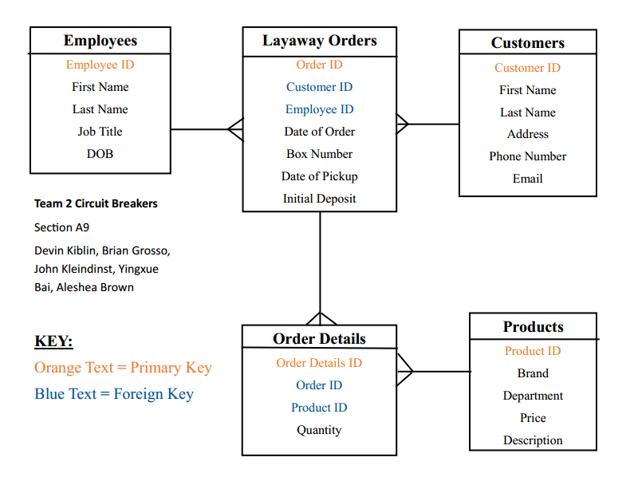
Design Overview
Notes:
-Instead of using paper forms, we have created a database that will process layaway transactions and generate reports related to the layaway process.
-The database will contain data related to all of the store’s customers, employees, products, and layaway transactions.

Slide 6
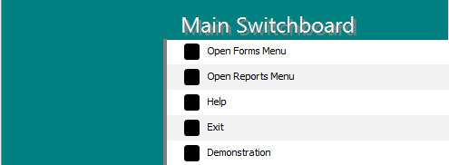
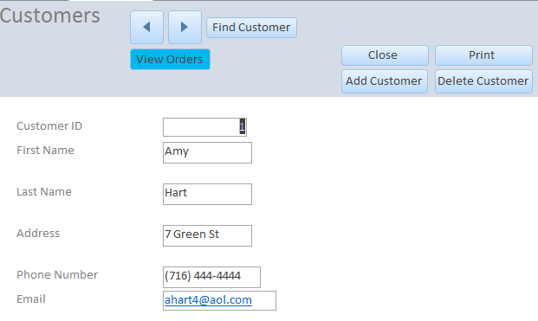
User Interface Design
Notes:
-Our user interface utilizes: switchboard menus, forms, linked forms, sub forms, and a navigation form. This makes for easy data entry and editing.

Slide 7
Advanced Elements
Queries
4/5 queries are grouped
6 total parameters used in 3/5 queries
5 concatenated fields used in 3/5 queries
Built field using DateDiff function used in 3/5 queries
Many uses of criteria
Reports
Made from advanced queries
Switchboard
Advanced Macros
Table
Multiple Dropdowns in Tables
Required Fields
Custom Input Mask
Forms/Subforms
Switchboard AND navigation form
Notes:
This is a list of advanced features incorporated into our database to improve functionality and user-friendliness.
For example, DateDiff, an advanced function, was used to compute how many days it has been since each layaway was opened.

Slide 8
Project Demonstration
Database Website

Slide 9
Conclusion
$10 million annual savings
Better customer service
Higher employee productivity
Integration potential
Notes:
-We estimate this will save the company over 10 million dollars a year in labor costs.
-Layaway transactions will take less time and customers will become aware when layaways are near and past due, resulting in improved customer service.
-Employees will no longer have to do tedious work, giving them time for other tasks.
-The layaway database can easily be integrated into Marshalls existing general inventory management database.

